Slide 1
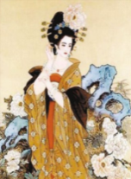
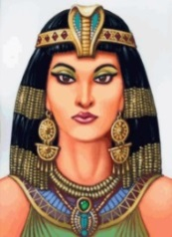
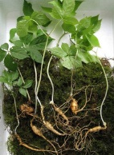
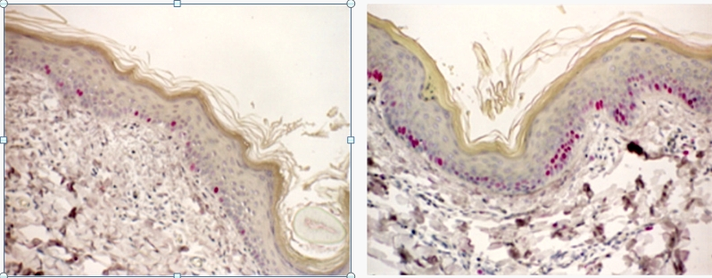
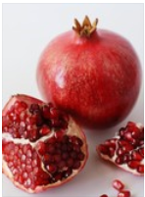
‘Ultimate Luxury Treatment’
Snail Essential 24K Gold Mask
Main Ingredients
1) 99.9%24K Gold
Stimulates circulation
Prevents wrinkles and other signs of aging
Immune system strengthening
Improves Cell metabolism. Overall skin condition improves.
Concept
”Luxurious anti-aging home treatment designed for various aging concerns. “
Gold therapy loved by Cleopatra and Yang Kuei-fei
It is widely known that Yang Kuei-fei loved taking bath with gold and that Cleopatra wore gold mask every night to retain her youthful skin.
Intense Deep Care
Gold luxury Formula
Lifting & Firming
24K gold 1000µg
Gold Snail Mucin Extract
1,000ppm
Wash-off type
Maximum hydration
Golden color
24K gold stimulates lifting effect
Ginseng-fed noble snail offers EGF to increase firmness.
2) Noble Snail Mucin
Mucin Is the bodily secretion to restore the damaged tissue of its body.
Stimulates collagen synthesis, helping to heal the damage
Rich in skin beneficial nutrients and softening agent.
Purifying & Detoxifying
3) EGF (Epidermal Growth Factor) to stimulate cell growth.
EGF is a growth factor in upper layers of the skin that stimulates cell growth, proliferation, and differentiation.
From mid 20, skin’s existing EGF starts to decrease, slowing the cell renewal. EGF can paly significant role in delaying this aging process.
Powerful anti-aging
Wrinkle Diminishing
Ultimate hydration and nourishment
Before
After EGF application.
Great skin renewal
Inner skin strengthening
Luxury care that gives a Noticeable difference
4) Pomegranate
Powerful antioxidant
Improves Hydration & Vitality

Slide 2
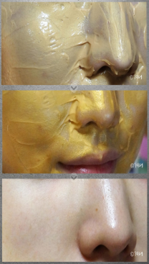
 | Name | Snail Essential 24K Gold Mask
 | Key Selling Point | Gold therapy antiaging care for an ultimate luxury skin treatment.
 | Ingredient | 24k gold 1000µg, Nobel snail mucin 1,000ppm
 | Vol/ price | 100ml / 18,000 won
 | Direction | After cleansing and toner, spread generous amount of the mask on entire face avoiding eye and lip area. Leave on for 15~20 minutes and wash off.
Feature | 1. Luxurious intense treatment Formulated with the powerful antiaging ingredients, 24K gold 1000µg and ginseng-fed noble snail mucin 1,000ppm, this mask offers noticeably improvement on overall skin condition 2. Renewal & Firmness Improvement Snail mucin and EGF maximizes skin’s renewing power, building the stronger protective layer on the surface 3. Vitality & Moisture Improvement - Phytoestrogen-rich pomegranate brings vitality to the complexion, and green tea seed oil provides deep hydration 4. Never-drying Gold Mask Formula - Unlike many other wash-off masks, this Snail Essential 24K Gold Mask does not dry out over time. It retains silky, hydrating formula over time.
Sales Talk
Comparison
Brand | The Saem | Medi-Peel | Tony Moly
Name | Snail Essential 24K Gold Mask | Skinday luxury 24K Gold Mask | Luxury Gem Gold 24K Mask
Image
price | 18,000 | 72,000 | 18,800
vol | 100ml | 250ml | 100ml
Sub ingre. | Noble snail mucin, EGF, pomegranate | Caviar, jojoba seed oil | Snail mucin, Caviar
“Gold antiaging care can be done at home.”
The gold therapy, a luxury skin treatment service done at the spa or dermatologist’s, can now be done at your own place for much lower price. It contains the real 24 K gold, which has an excellent antiaging power. It will stimulate the poor circulation , detoxifies and offers lifting effect. And 24K gold is not everything this mask contains. It also contains ginseng-fed snail mucin , great renewing-agent, EGF and phyto-estrogen pomegranate. Your skin deserves this special & luxurious treatment.
Special, luxury treatment of the Professional spa
can be done at your Home for Absolutely reasonable price!
Ginseng-fed snail and Cell Growth factor, EGF,
boost up the anti-aging effect !
Non-drying mask, super nourishing formula
offers an effective Gold Therapy Care!

